Slide 1

ITA0506-Computer Vision
Fundamental Stages of Digital Image Processing in Computer Vision Systems
Guided BY
Dr.R.C.Jeni Gracia
By
T.V.SAI JAGADEESH
(192472146)

Slide 2


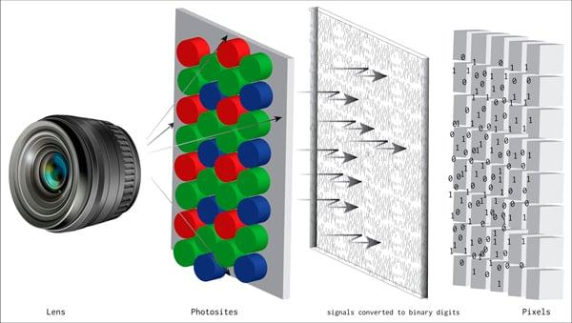
Image Acquisition
Image acquisition is the process of capturing real-world scenes using cameras or sensors.
It converts light energy from the environment into electrical signals that can be processed digitally.
Important influencing factors include:
Type of sensor used (CCD or CMOS)
Resolution of the camera
Lighting and exposure conditions
Presence of noise or environmental disturbances

Slide 3
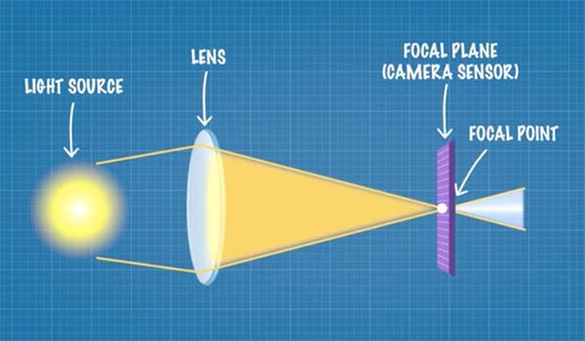
Image formation
Image formation is the physical process of creating an image on the
sensor surface
Light rays from objects pass through an optical system such as a lens .
The lens focuses and directs light onto the camera sensor .
This process creates a 2D projection of a 3D real-world scene .
Improper image formation leads to blurred or distorted images.

Slide 4
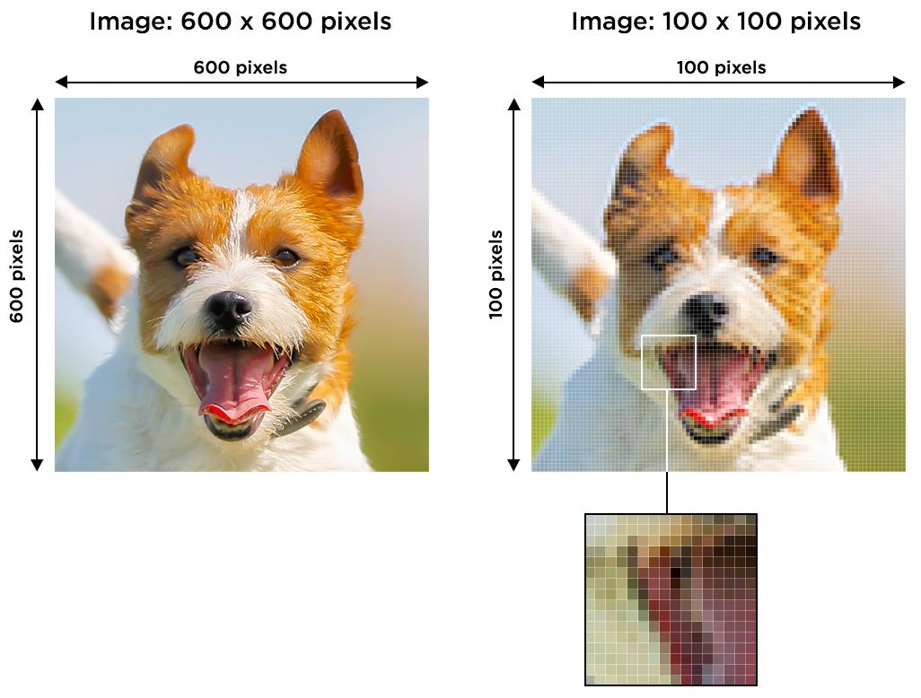
Sampling
Sampling is the process of converting a continuous image into a discrete digital form.
It divides the image into a grid of small elements
called pixels.
Each pixel represents a small portion of the image.
Sampling determines the spatial resolution of the image.
Lower sampling reduces image clarity and may lose important
information.

Slide 5
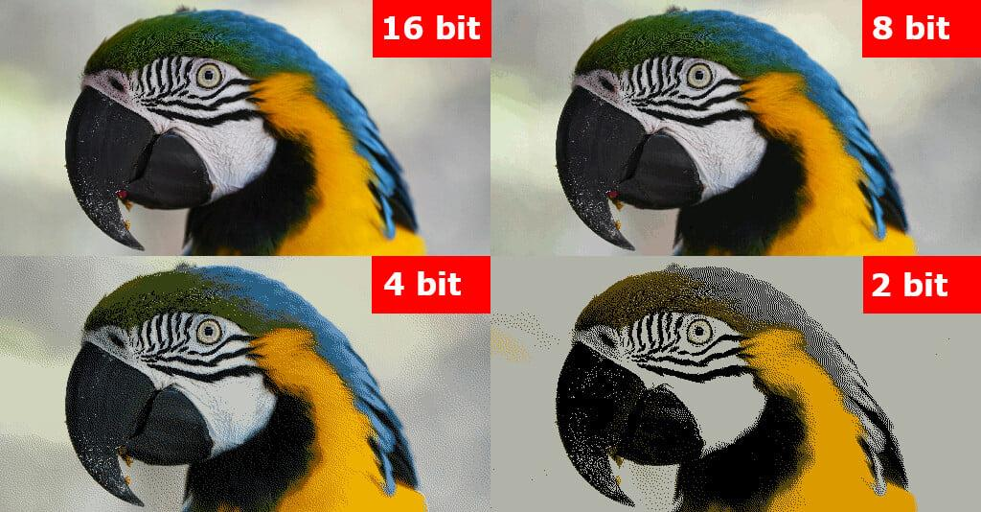
Quantization
Quantization is the process of assigning intensity values to each pixel
It converts continuous intensity values into a limited number of discrete levels .
These levels represent brightness or color information in the image
Higher quantization levels produce smoother and more detailed images
Lower quantization levels may cause loss of detail and banding effects

Slide 6
CONCLUSION
All stages work together to convert a real-world scene into a digital image .
The process follows a sequential flow:
Image Acquisition → Image Formation → Sampling → Quantization
Each stage depends on the output of the previous stage.
Errors or limitations in one stage affect the overall system performance.
High-quality acquisition and formation lead to better sampling and quantization results.
Used in real-world applications such as face recognition, medical imaging, and autonomous driving.

